Slide 1
Bacchus Winery Case Study
JOSHUA Martin
Brooks Roberts
Milestone 4

Slide 2

Introductions
Lets meet the Project Group 5 team:
Joshua Martin
Brooks Roberts
Goal
Our goal is to streamline inventory management, improve supply tracking, and enhance customer experience for Bacchus Winery.

Slide 3

Bacchus Winery Overview
Bacchus Winery produces Merlot, Cabernet, Chablis, and Chardonnay.
Inherited from George Bacchus, Stan and Davis Bacchus seek to incorporate new business methods to improve products and customer service.

Slide 4
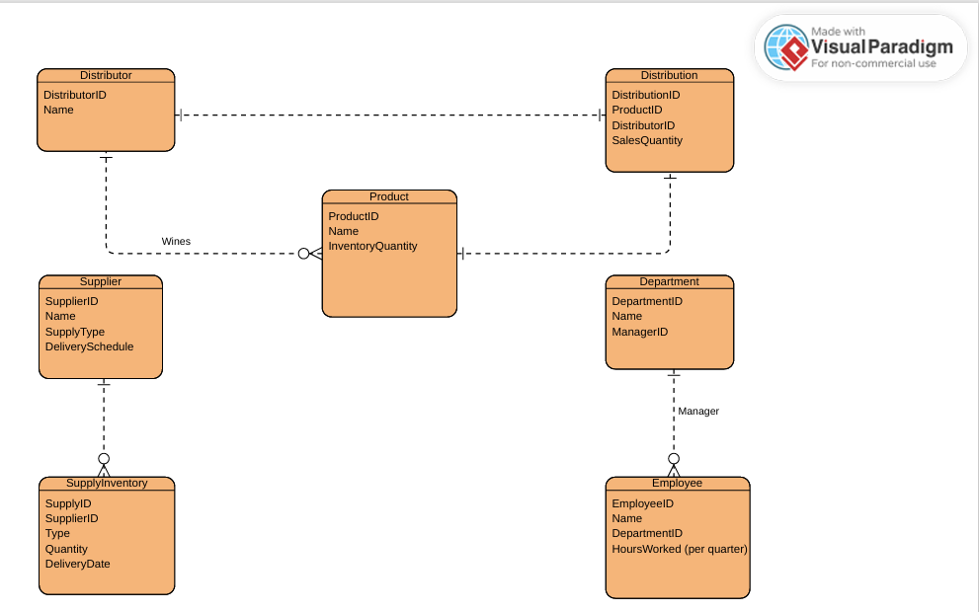
ERD Entities and Relationships

Slide 5

Description of Reports
Supplier Delivery
Wine distribution
Employee Work hours

Slide 6
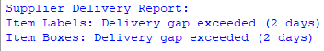
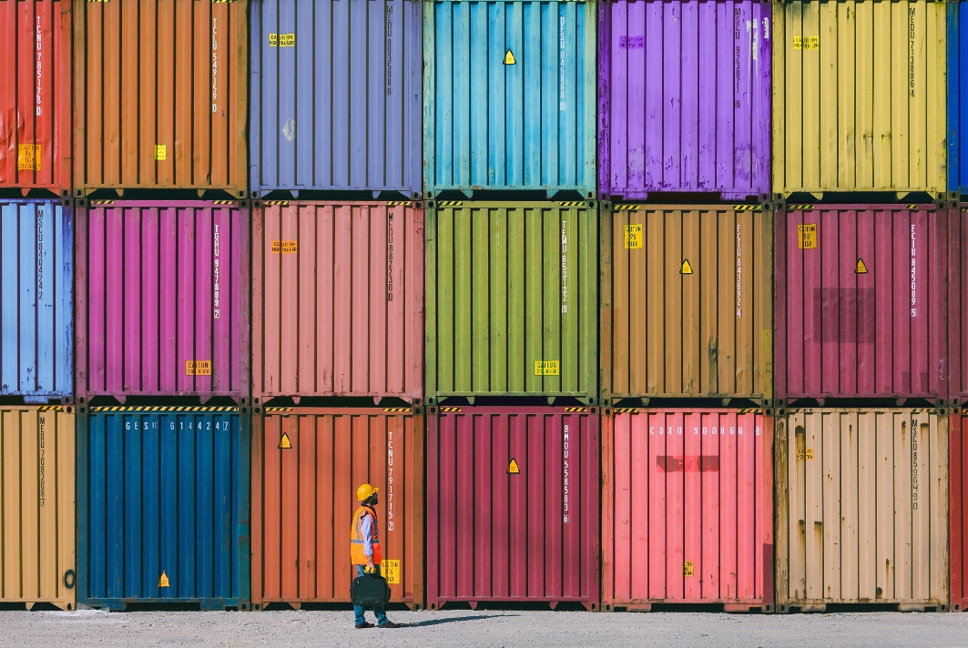
Supplier Delivery Report
Supplier2 shows an average of a 2-day gap that exceeds expected delivery date.

Slide 7

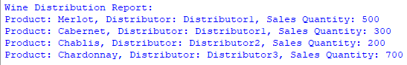
Wine Distribution Report
Strongest selling wine;
Chardonnay
Weakest selling wine;
Chablis

Slide 8

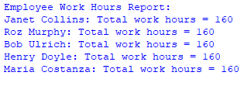
Employee Work Hours Report
Over the last four quarters of tallying hours per week each month it’s been determined each employee works an average of 40 hours a week.

Slide 9

Assumptions
We assume that the existing personnel are accurately tracking data.
We assume that the delivery gaps are consistent indicators of supplier performance.
We assume that the overall business remains relatively stable during the analysis period.
We assume that employee performance remains consistent over the quarters.

Slide 10
Thank You
Project group 5

